Slide 1
Fish Quality Classification Project
Comprehensive Experiment Review
Sowmya Maddala • 22.10.2024

Slide 2
Project
Overview
Objective:
Classify fish images into "Good" or "Bad" categories based on the quality
Species Focus:
Sardine
Motivation:
Improve model performance for app testing

Slide 3
Data Collection and Preparation
Data Sources
Daily data collected from S3 and manual data till Oct-8-2024, uploaded to Kaggle as private dataset
Dataset Segmentation
Segmented and organized “single” fish image data into ‘Good’ and ‘Bad’ folders in Kaggle.
500 images of the app testing data per class has been included in training and validation datasets as they are 3 fish “group” images.

Slide 4
Data Distribution
Dataset | Good | Bad
Training | 5968 | 6010
Validation | 1869 | 1873
Test | 1712 | 1711
Unseen | 50 | 51
App testing data | 1423 | 670

Slide 5
Hyperparameter Tuning
Batch sizes: 16, 32, 64
Dropout rates: 0.1 to 0.5
Learning rates: 1e-5 to 0.01
Dataset sizes: 1000 to 4000 for each class
best hyperparameter selection: grid search cv and random search cv, keras auto tuner.
Epochs: 10 to 200
Preprocess input functions : densenet, mobilenet
Data augmentation
Dataset versions: only softness, single softness, single+group softness, all combined
Different pre-trained imagenet models as base models.

Slide 6
Experiment 1: Initial Model Training
Model Architecture:
Base Model: DenseNet121
Layers: Global Average Pooling 2D, Dense (128 neurons), Dropout (20%), Dense (32 neurons), Sigmoid Output.
Framework and Configurations:
TensorFlow Version: 2.15
Training for 50 epochs, batch size of 32, input size 224x224 without data augmentation
Callbacks: ReduceLROnPlateau, EarlyStopping.
Results:
Training Accuracy: 77%
Validation Accuracy: 74%
Testing Accuracy: 73%
Unseen Data Accuracy: 76%
Insights: Initial model showed
good promise but indicated overfitting.

Slide 7
Experiment 2: Adding Regularization and More Layers
Updated Model Architecture:
Base Model: DenseNet121
Additional Layers: Global Average Pooling 2D, Dense (512 neurons, L2 regularization 0.0001), Dense (128 neurons), Dropout (20%), Dense (32 neurons), Sigmoid Output.
Framework and Configurations:
TensorFlow Version: 2.10
Training Configuration: Same as before, but training stopped early at the 18th epoch due to EarlyStopping.
Results:
Training Accuracy: 82%
Validation Accuracy: 76%
Test Accuracy: 76%
Unseen Data Accuracy: 80%
Challenges Faced:
App testing data predictions were biased towards the "Good" class.
Hypothesized that the lack of segmented group fish images in training data contributed to bias.

Slide 8
Experiment 3: Increased neurons
Updated Model Architecture:
Base Model: DenseNet121
Layers: Global Average Pooling 2D, Dense (512 neurons, L2 regularization), Dropout (20%), Dense (256 neurons), Dense (32 neurons), Sigmoid Output.
Framework and Configurations:
TensorFlow Version: 2.10
Training Configuration: Same as before
Results:
Similar performance; training and validation metrics did not improve significantly.

Slide 9
Experiment 4: Batch Normalization and additional fine-tuning
Modifications
New Dataset Version: Included segmented images of group fish (500 images per class for training and validation) from app testing data in training and validation data.
Incorporated Batch Normalization:
Significance: Normalizes outputs for faster training and better performance.
Enhanced model stability and convergence.
Architecture:
Included Batch Normalization layers after dense layers.
Applied L2 Regularization in the output layer to prevent overfitting.
Further Model Changes: Enabled all layers of the base model for training (fine-tuning).

Slide 10
Experiment 4: Batch Normalization and additional fine-tuning
Framework:
TensorFlow Version: 2.16 (model loading issue fixed).
Training Configuration:
Continued training from saved weights (previous 50-epoch model).
Learning Rate: Lowered to 1e-5.
Ran for 20 epochs with data augmentation.
Performance Results:
Training Accuracy: 88%
Validation Accuracy: 81%
Test Accuracy: 83%
Unseen Data Accuracy: 86%
App Testing Data Accuracy: 81%
Insights: The introduction of batch normalization significantly boosted performance metrics.

Slide 11
Experiment 5: Exploring Other Base Models
1
Pre-trained models tested
2
Learning Rate Schedulers
3
Model Weights Used
MobileNet V2
DenseNet 121
DenseNet 169
DenseNet 201
VGG 16
VGG 19
Resnet
Compared Exponential Decay vs. ReduceLROnPlateau, with ReduceLROnPlateau being most effective.
Both checkpoint and final weights are viable options for fine-tuning, but checkpoint weights can help resume training from an earlier point in case of interruptions.

Slide 12
Results Summary
Pre-trained Model | Validation Accuracy | Test Accuracy | App testing accuracy
MobileNet V2 | 83 | 80 | 79
DenseNet 121 | 81 | 83 | 81
DenseNet 169 | 79 | 81 | 79
DenseNet 201 | 80 | 82 | 80
VGG 16 | 81 | 77 | 76
VGG 19 | 81 | 79 | 80
Resnet | 79 | 75 | 77

Slide 13
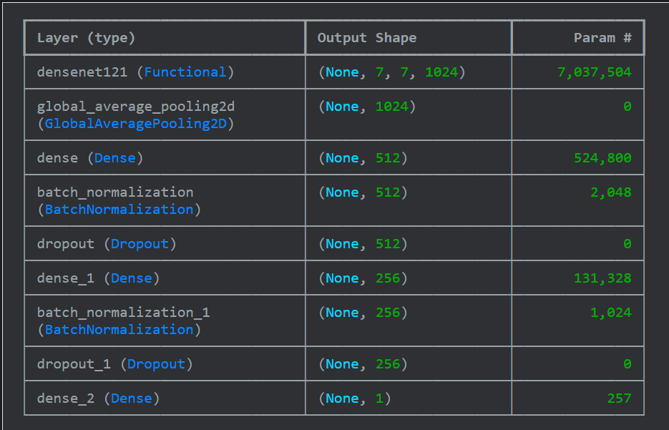
Current Best Performing Model Architecture

Slide 14
Confusion Matrices Analysis
Achieved 86% accuracy on October 8-20 data collected.
Link to Confusion Matrices Presentation: [Link]

Slide 15
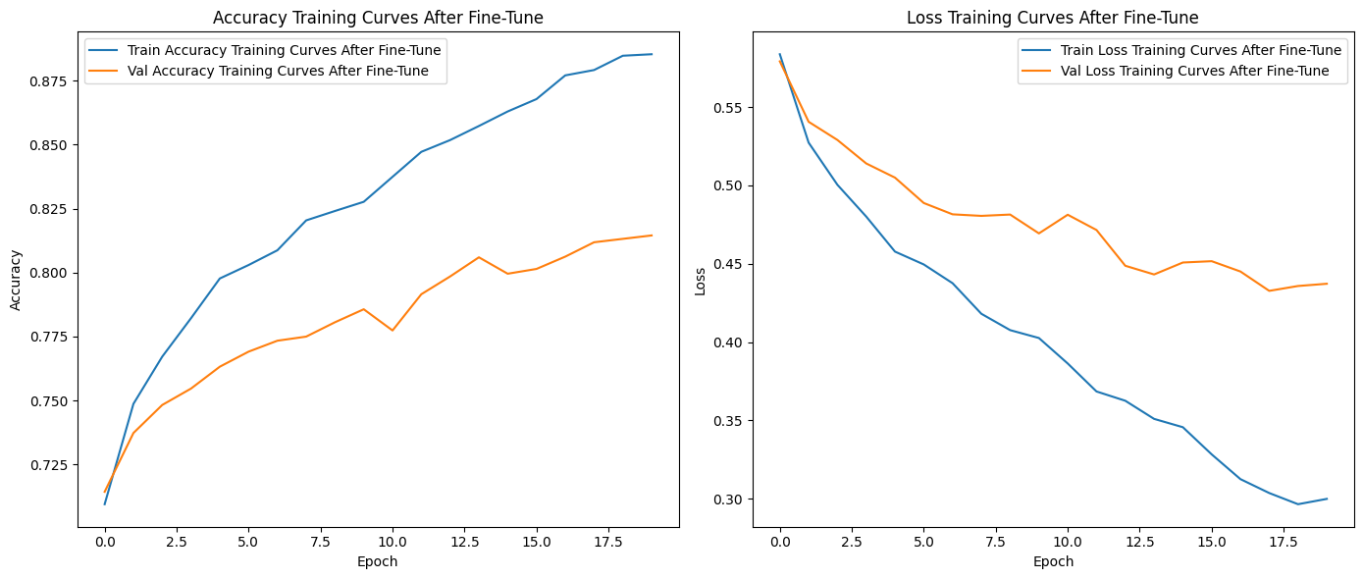
Training Accuracy Loss Plots of fine-tuning

Slide 16
Challenges Faced
Initial Issues:
Older TensorFlow versions gave errors; switched to 2.16.
Saving the models in tensorflow SavedModel format.
Managing storage for segmented datasets.
Biased Results:
Challenges with app testing data (biased towards "Good").
Resolution: Included segmented group fish images for better generalization.
Internet connectivity issues causing training interruptions.

Slide 17
Conclusion
Model Performance
Batch Normalization
Regularization Impact
- DenseNet121 outperformed others, achieving 83% testing accuracy and 82% app testing accuracy.
- Fine-tuning this model significantly enhanced its performance for our specific dataset.
This technique accelerated training and enhanced accuracy, proving essential in our deep learning approach.
The inclusion of L2 regularization, especially at output layer, and dropout layers significantly improved performance by reducing overfitting.

Slide 18
Future Work
Explore various machine learning models to further improve accuracy.
Use the best-performing model as a feature extractor.
Implement PCA and LDA for dimensionality reduction on a larger dataset.
Aim to enhance model robustness through iterative testing and adjustments.

Slide 19
Thank You!

